Slide 1

Web development at “digital hub solutions ltd.”
Name: Jasmine Ara
ID: 161014030
Supervised By
Dr. Abul Kalam Al Azad
Associate Professor
Computer Science & Engineering
ULAB

Slide 2

COMPANY PROFILE
Digital Hub Solutions Ltd is an Ecommerce Website Development Company in Bangladesh .
Digital Hub Solutions Ltd established in 2015.
It is a private limited company in Bangladesh.
They provides the services of-
Software Development
Website Design and Development
Graphic Design Services
Technology Consulting

Slide 3
My jobs and responsibilities
Learning Laravel for the back end development.
Converting some PSD into HTML for front end practice.
Giving deadline for every work and bound to complete the given task within the deadline.
Free to ask my IT team members for any kind of technological help.

Slide 4
TRAINING MANAGEMENT SYSTEM
Training Management System is a web based system in which a training center can keep all the records of their students and teachers.
It’s a web based application.
Training Management System can help them to save their time.
This is a system that will help them to work more faster.

Slide 5
My project requirements
I was told to make a web based application for a training center in which an admin can-
register an account
login the account
register a students account
manage students account
allocate courses and times
add users
Logout the account

Slide 6


Tools & technologies
Technology tools:
IDE – Sublime Text3
Languages - HTML5, CSS3, PHP, JavaScript
Frameworks – Laravel, bootstrap
Database – Microsoft SQL server
Server – Web Server

Slide 7
INTRODUCING LARAVEL
An open-source PHP framework designed to make developing web apps easier and faster through built-in features
Follows a model-view-controller design pattern
Automatic testing

Slide 8
Why use laravel?
Makes the app development process easy and quick
Takes care of the security within its framework
Routing process remains simple
Creates a simple integration process with the third-entity libraries
Cost effective
Fast development time

Slide 9
Functions of my project
Login
Register
Students Registration
Users Registration
Students Profile
Logout

Slide 10
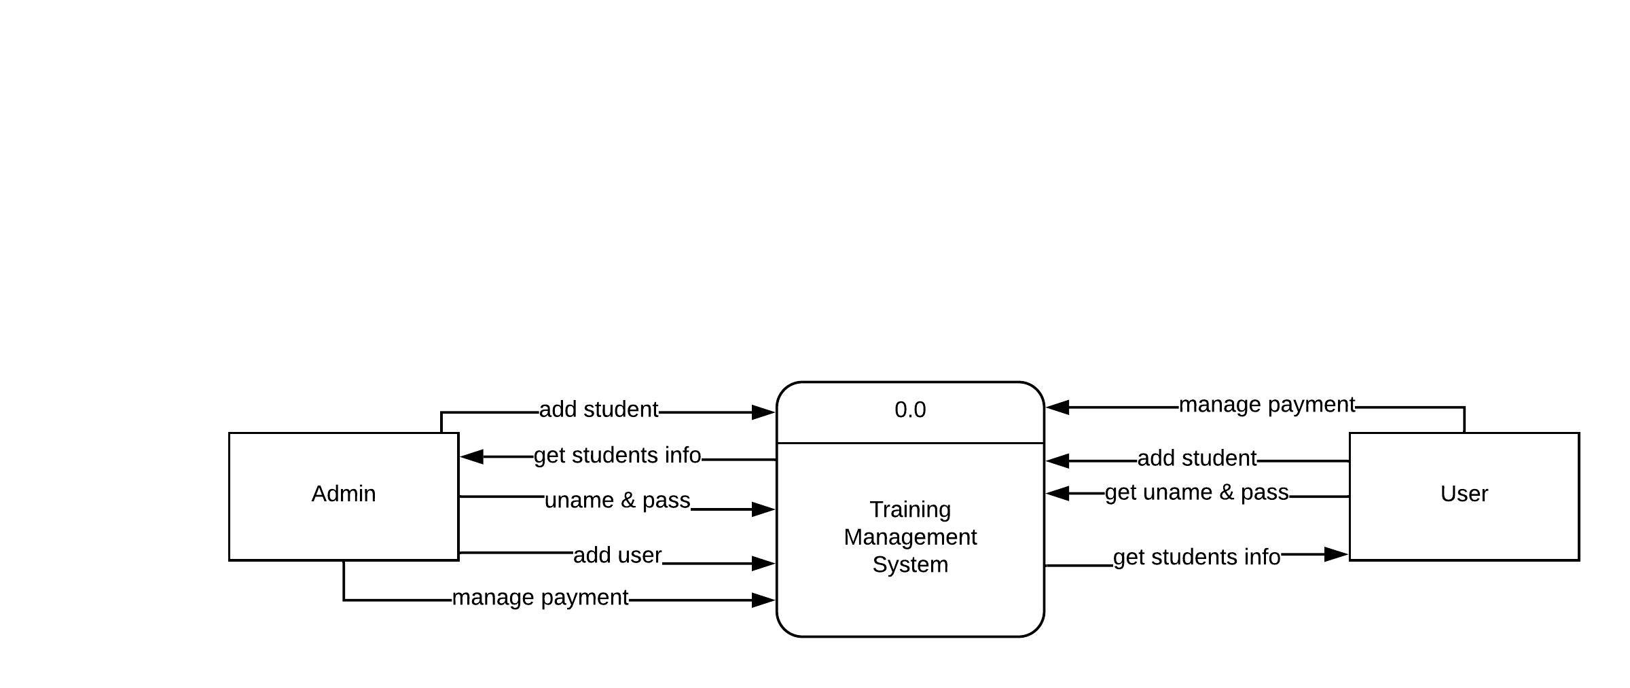
Context level diagram

Slide 11
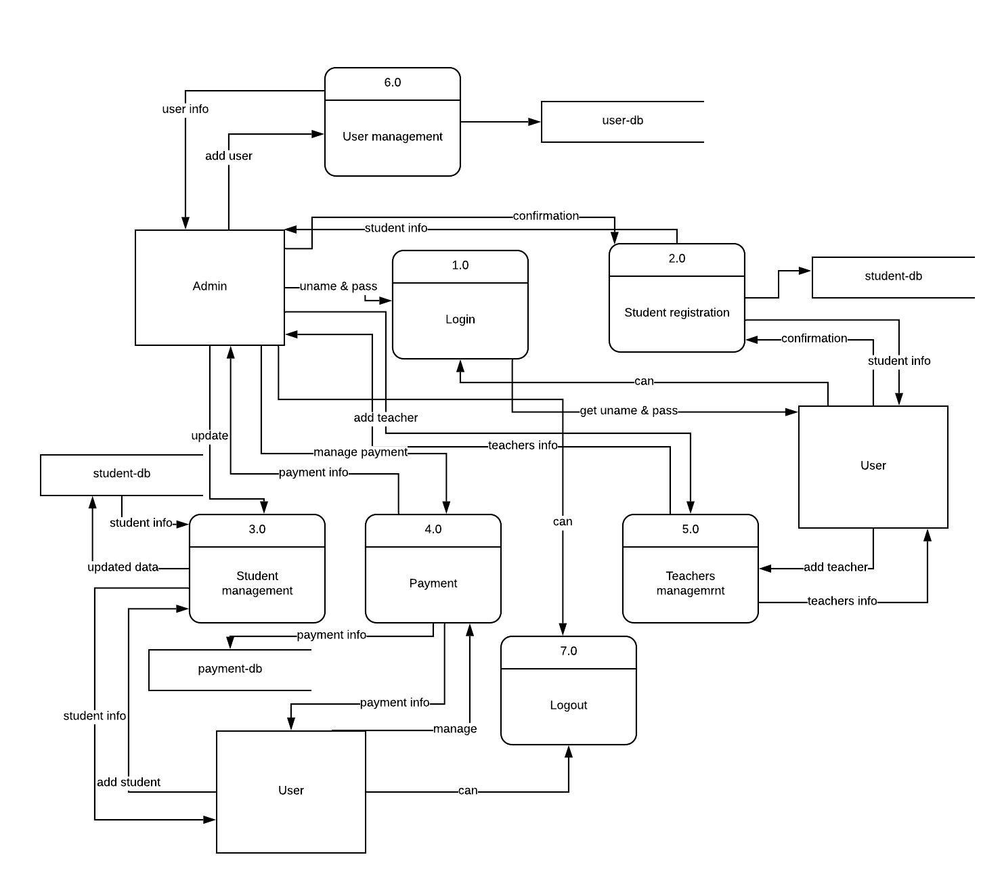
Level1 data flow diagram

Slide 12
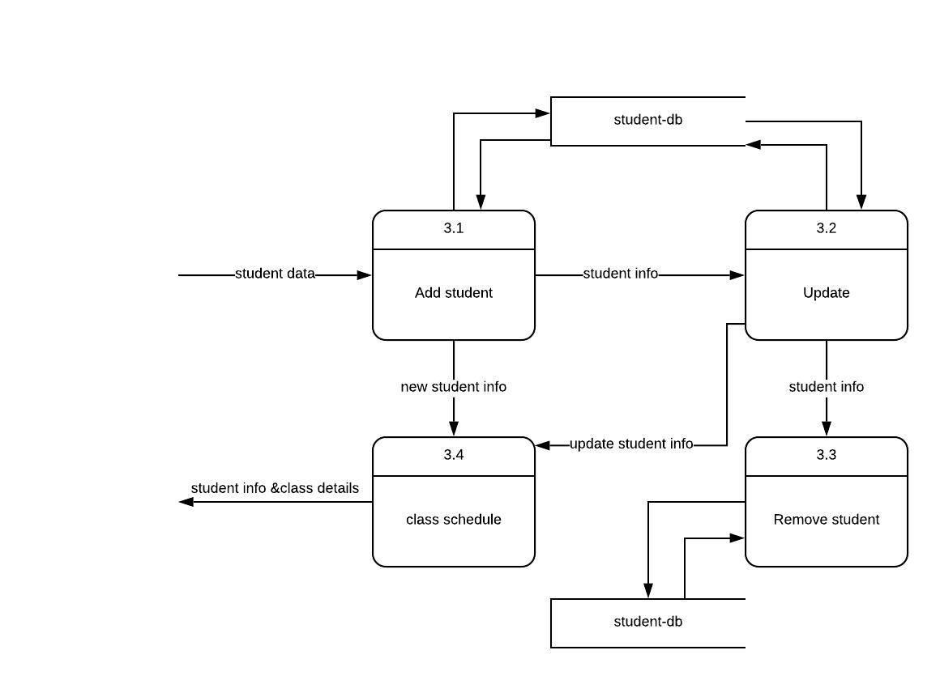
Level2 data flow diagram

Slide 13
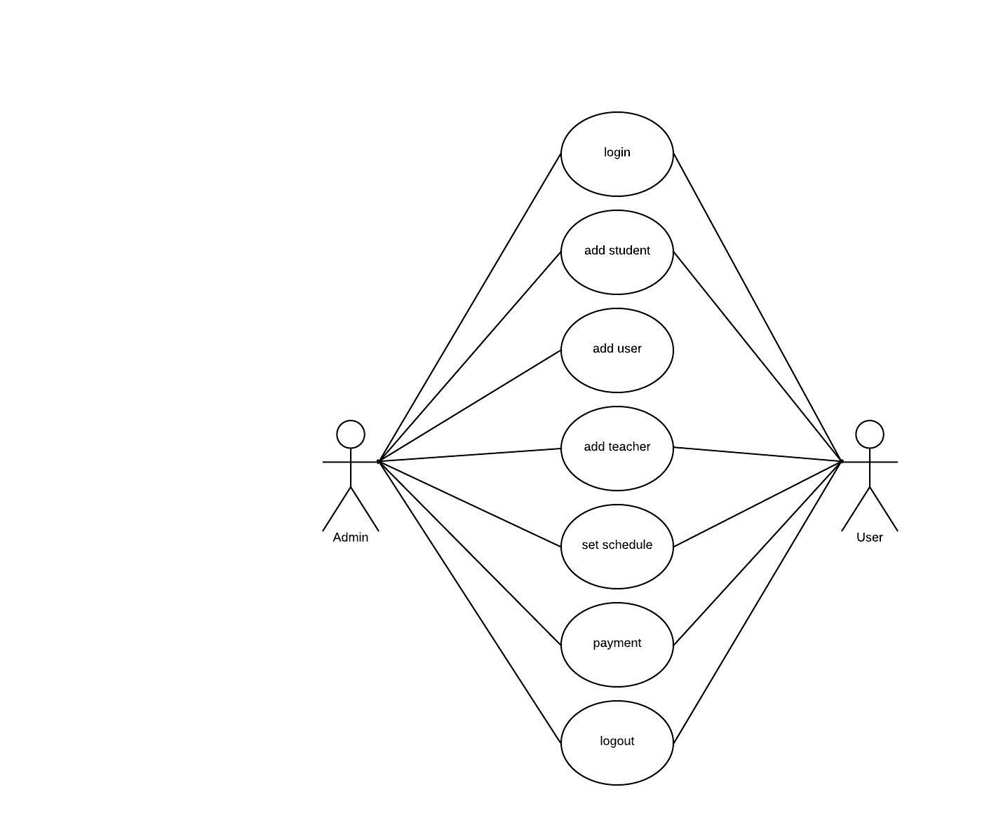
Use case diagram

Slide 14
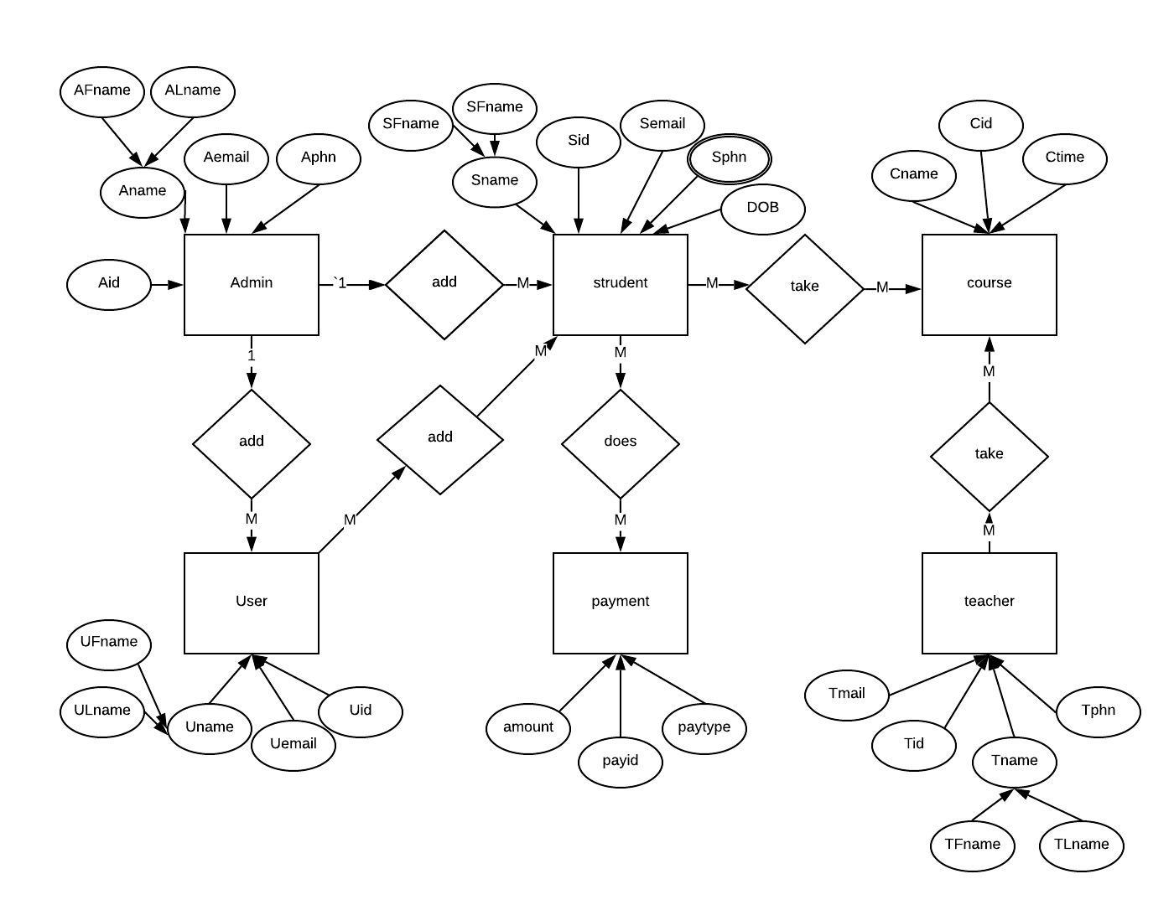
Entity relationship diagram

Slide 15
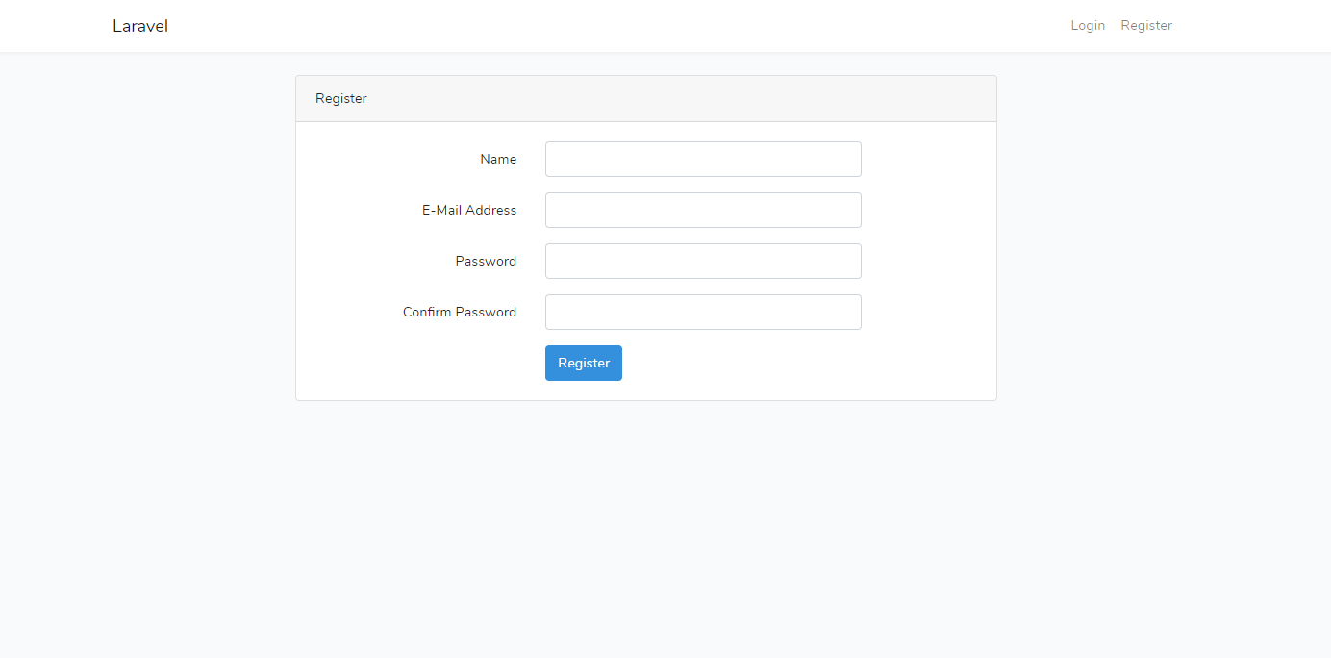
Registration page

Slide 16
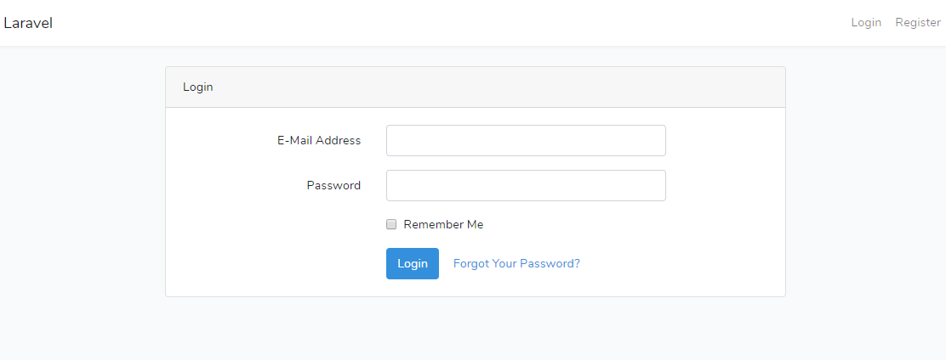
Login page

Slide 17
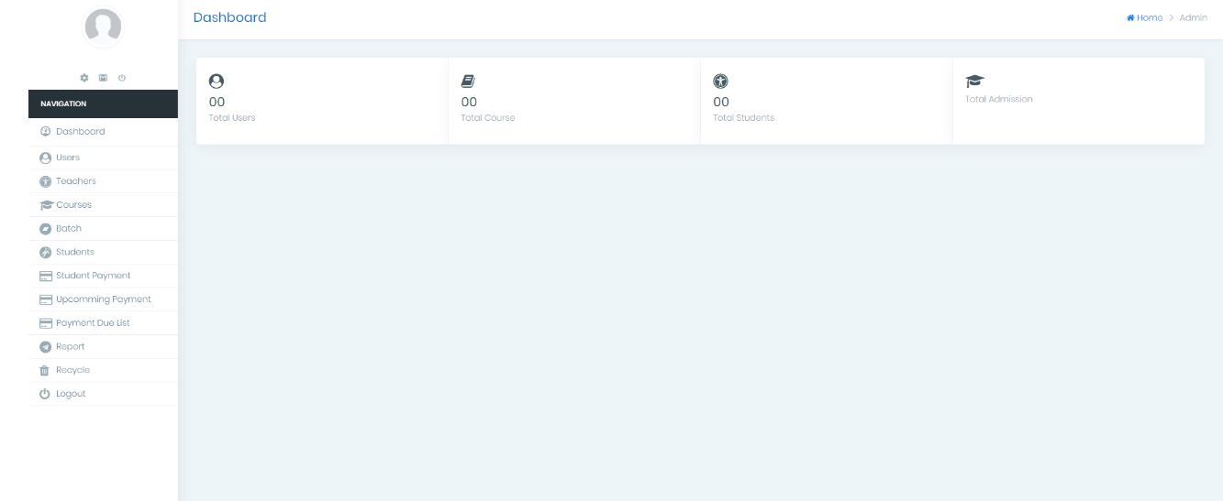
dashboard

Slide 18
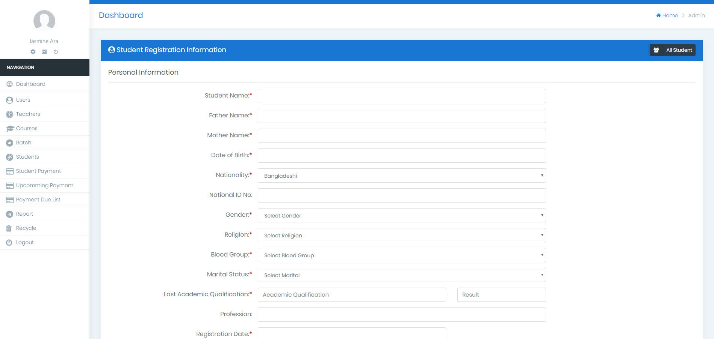
Student Registration form

Slide 19
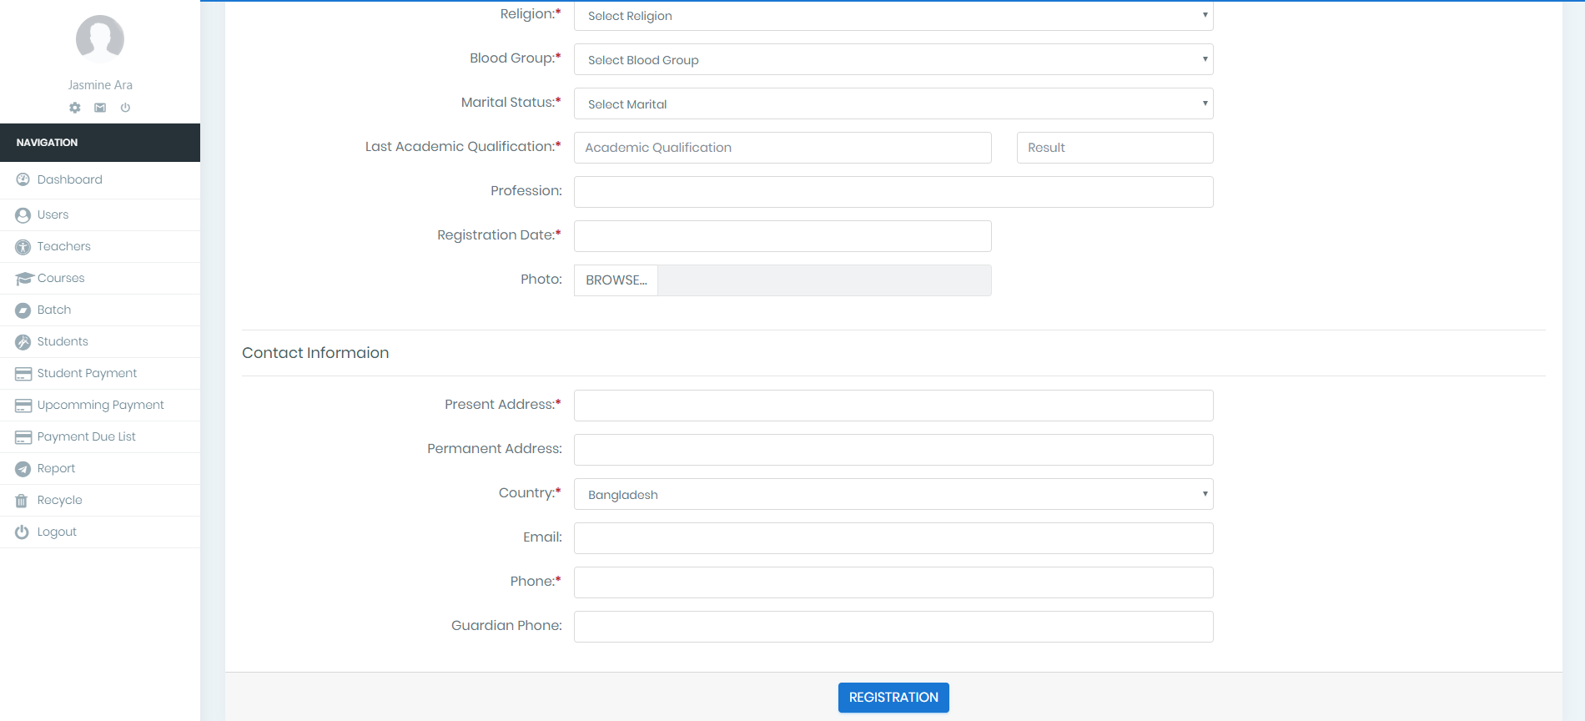

Slide 20
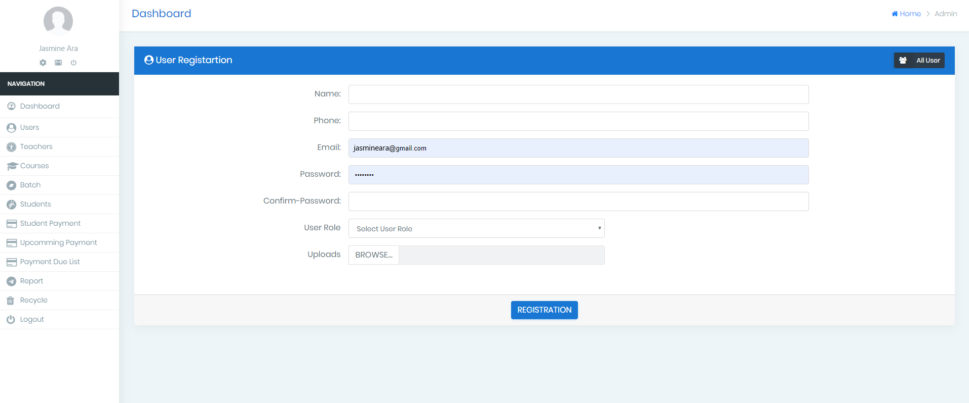
User registration form

Slide 21
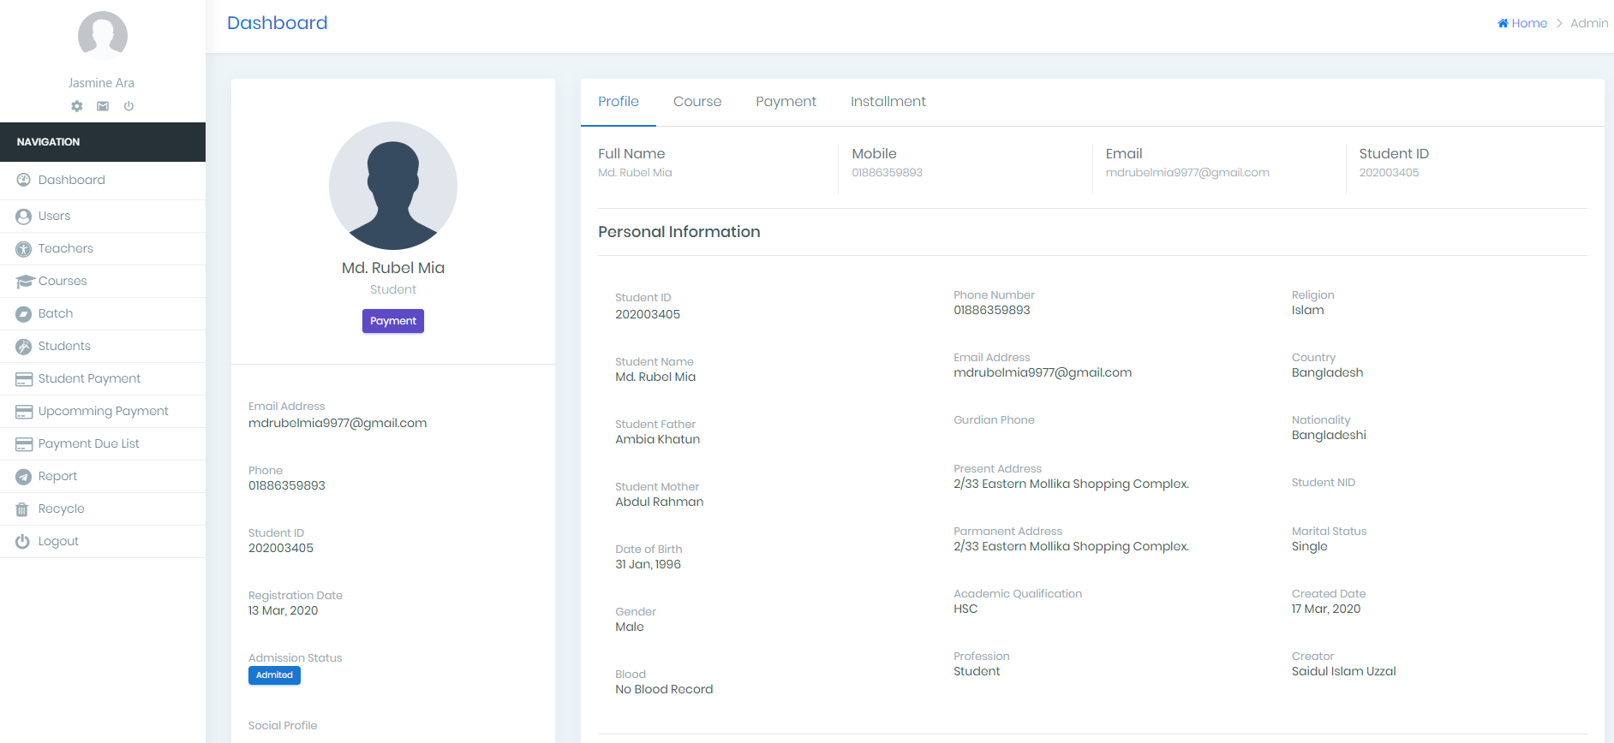
Student profile

Slide 22

Project benefits
This system will save their working time
Working sector will be more digitalized
Employees will be more smart to use the system in their work place
It has edit, update and report generation option
It will maintain systematic record

Slide 23

troubleshooting
I am not expert in Laravel. I learned Laravel during my internship period to build this project. So it may have some lacking's.
Design is constrained employees satisfaction

Slide 24
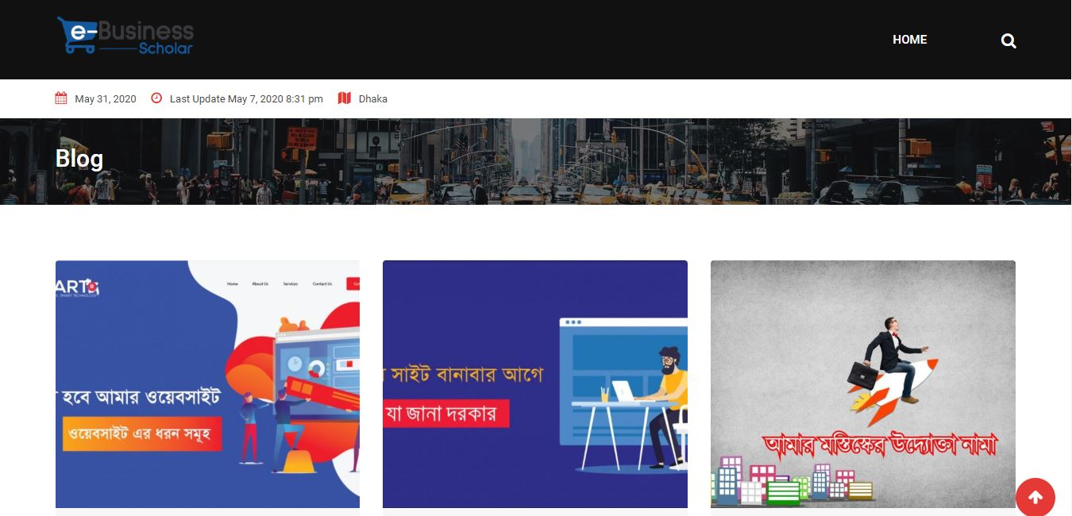
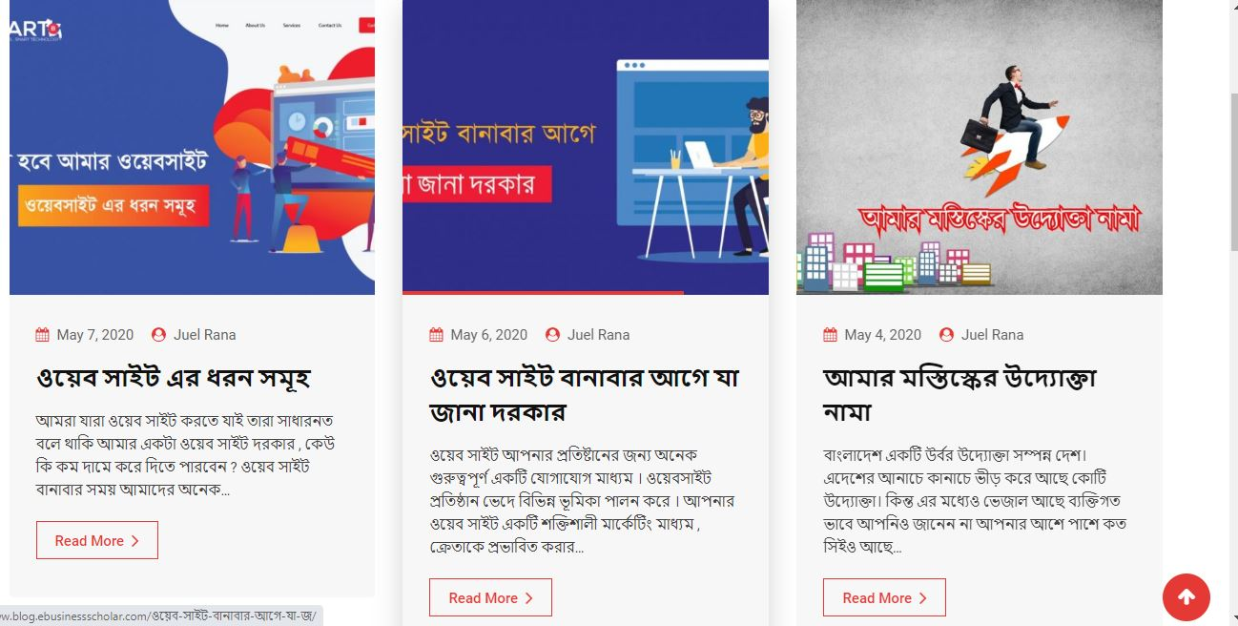
Project 2

Slide 25
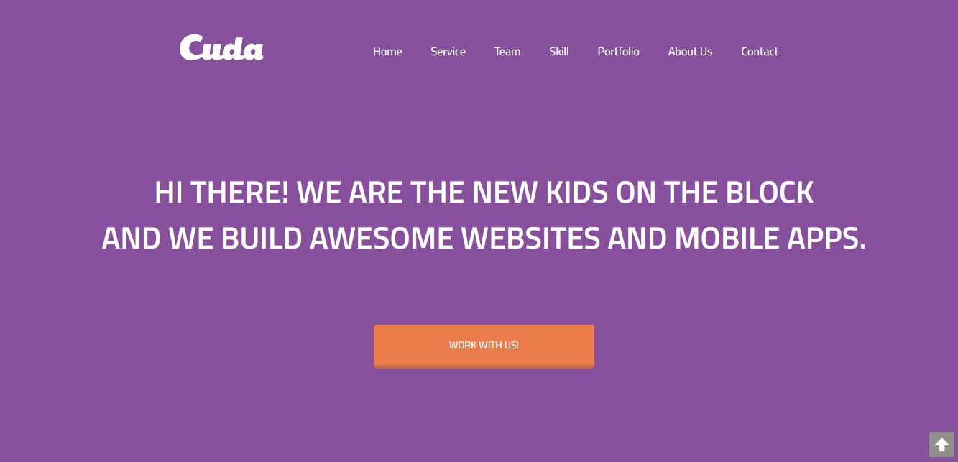
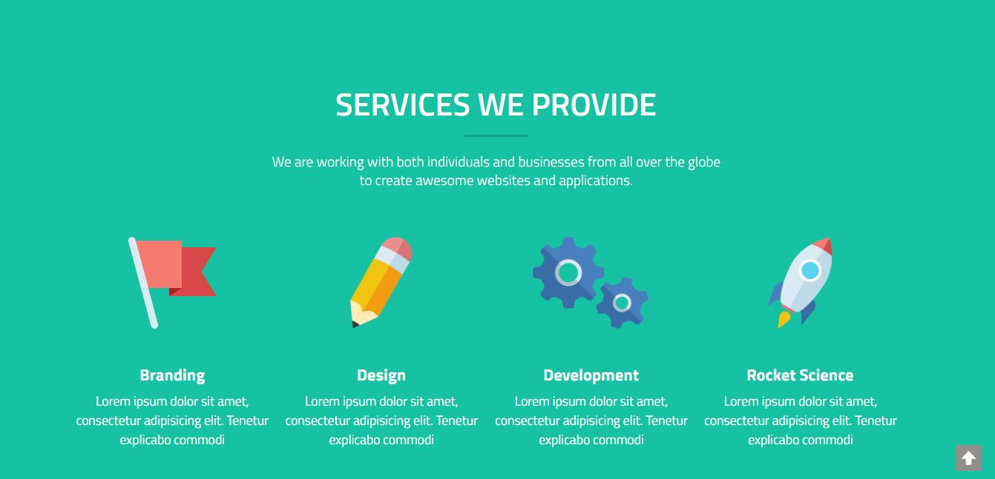
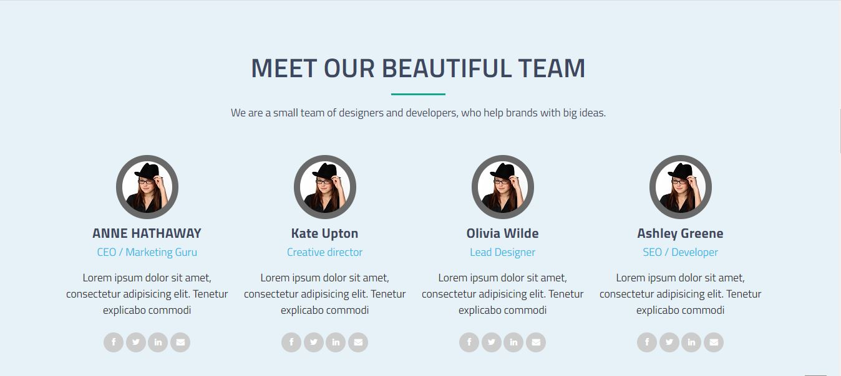
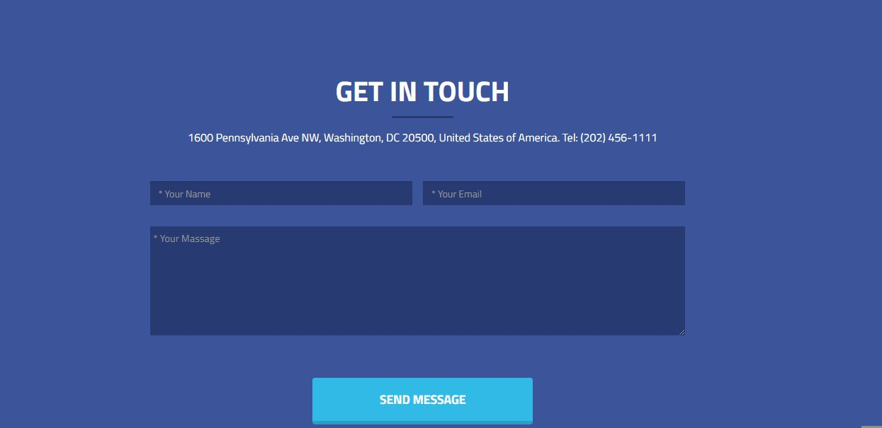
Project 3

Slide 26
Thank You

